Slide 1
APL 745: Deep Learning in Mechanics
Topics:
Convolutional Neural Networks
What is a convolution?
FC vs Conv Layers
Sitikantha Roy
IIT Delhi

Slide 2
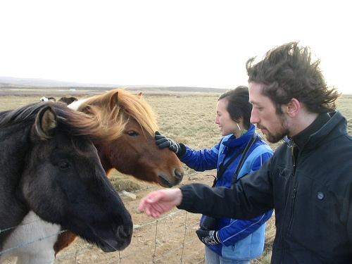
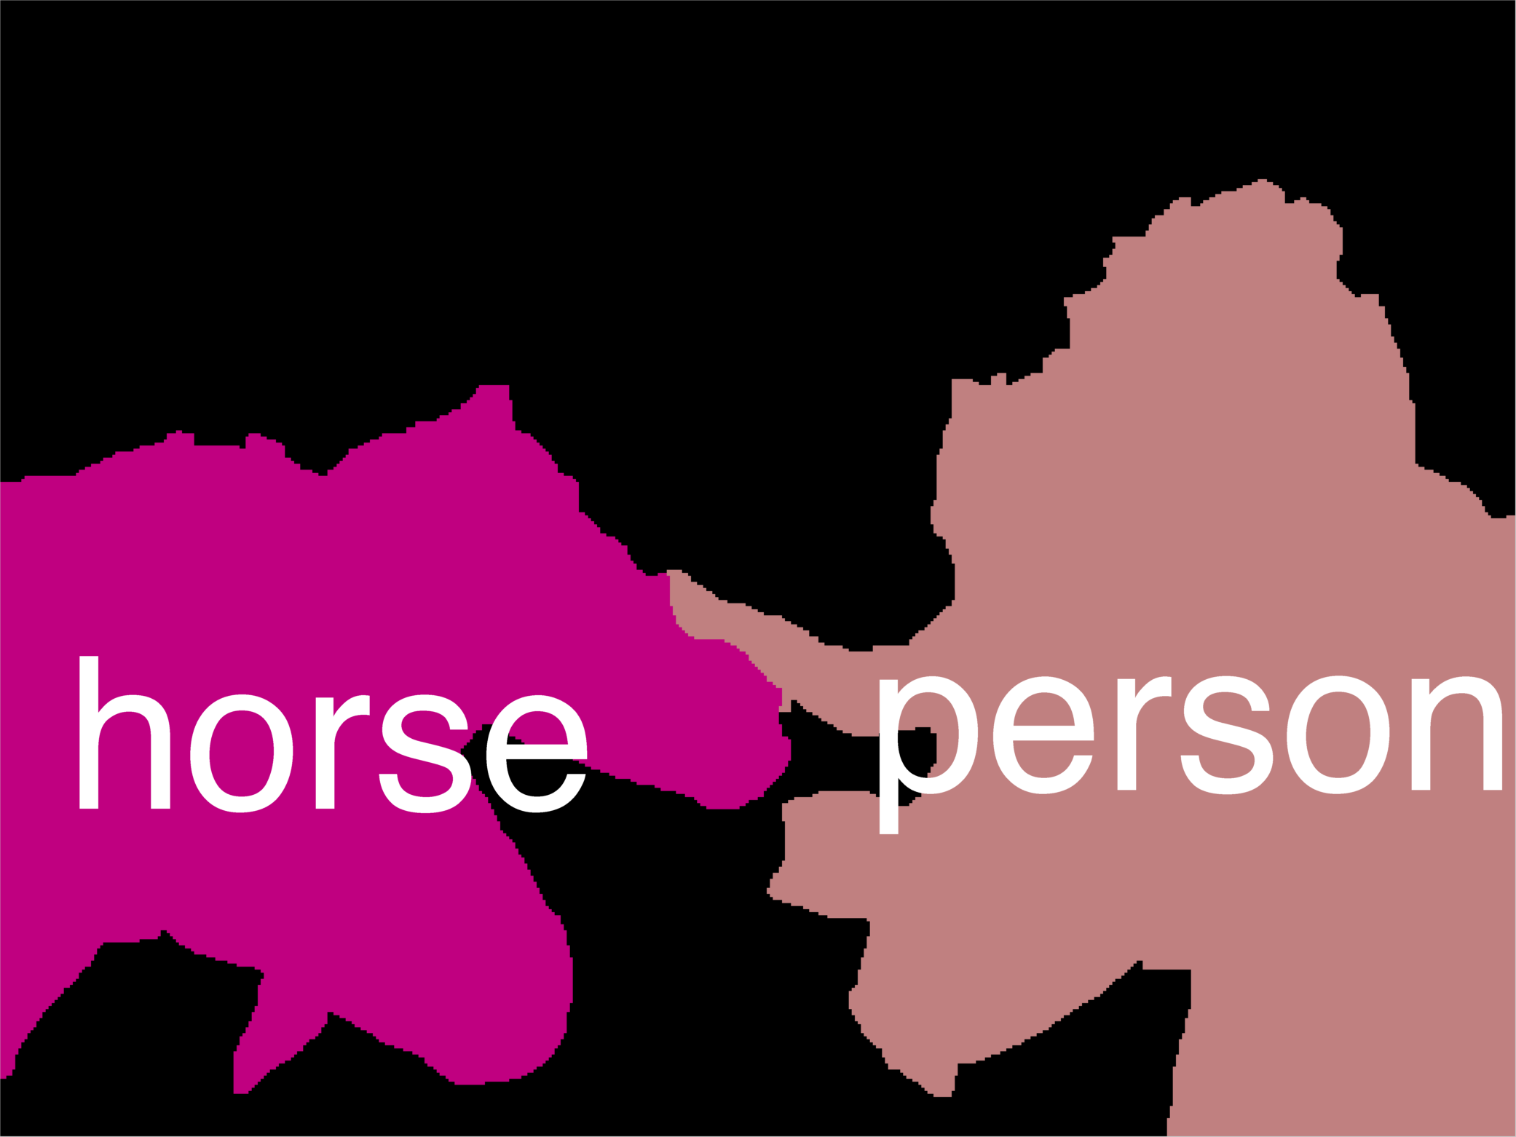
Error Decomposition
Reality
Multi-class Logistic Regression
Modeling Error
Softmax
FC HxWx3
Input
Estimation Error
Optimization Error = 0
model class

Slide 3
Recall the past
Convolutional Neural Networks
What is a convolution?
FC vs Conv Layers

Slide 4
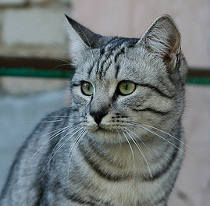
Recall: Linear Classifier
3072x1
f(x,W) = Wx + b
10x1
Image
10x1
10x3072
f(x,W)
10 numbers giving class scores
Array of 32x32x3 numbers
(3072 numbers total)
W
parameters
or weights

Slide 5
Example with an image with 4 pixels, and 3 classes (cat/dog/ship)
Stretch pixels into column
56
231
24
2
0.2 | -0.5 | 0.1 | 2.0
1.5 | 1.3 | 2.1 | 0.0
0 | 0.25 | 0.2 | -0.3
1.1
3.2
-1.2
-96.8
437.9
61.95
Cat score
56 | 231
24 | 2
+
=
Dog score
Ship score
Input image
W
b

Slide 6
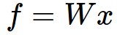
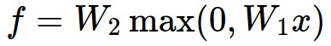
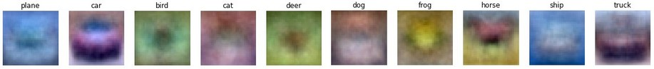
Recall: (Fully-Connected) Neural networks
(Before) Linear score function:
(Now) 2-layer Neural Network
x
h
W1
W2
s
3072
100
10
Notes:
Biological inspirations to neurons in brain that we’ll discuss later
Looking at it mathematically first, one thing this can help solve, is if we look back to our linear score function, each row of W corresponded to a template
Problem that there can be only one template per class, can’t look for multiple modes
Now intermediate layers can represent anonymous templates that later get recombined
Intermediate layers anonymous templates that get recombined. solves mode problems

Slide 7
Convolutional Neural Networks
Local connectivity
Parameter sharing

Slide 8
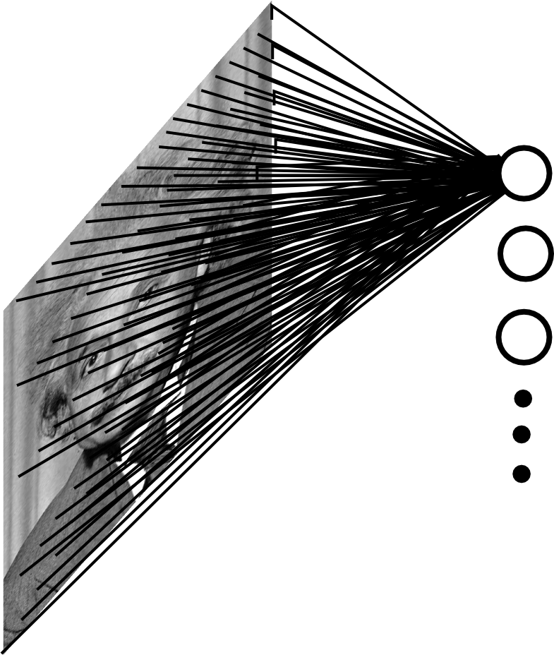
Fully Connected Layer
Example: 200x200 image
40K hidden units
Q: what is the number of parameters in this FC layer?

Slide 9
Fully Connected Layer
Example: 200x200 image
40K hidden units
Q: what is the number of parameters in this FC layer?
A: ~2 Billion
- Spatial correlation is local
- Waste of resources + we have not enough training samples anyway..

Slide 10
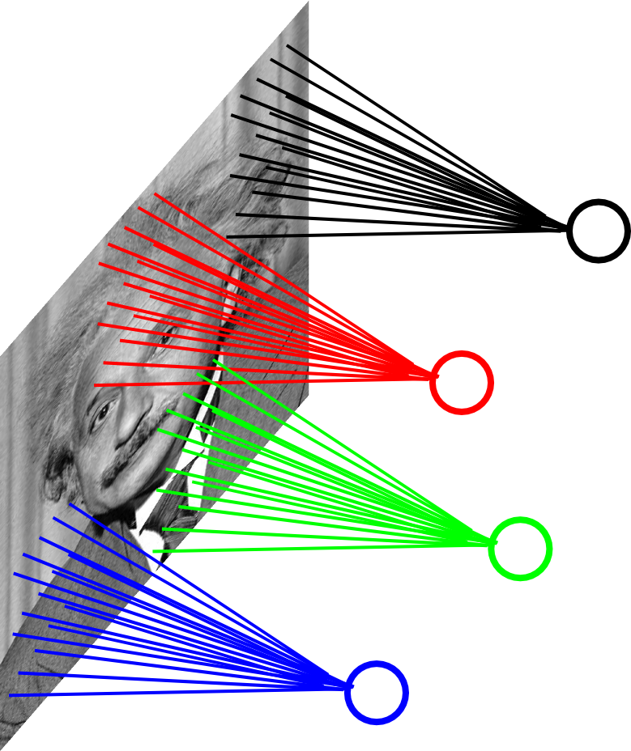
Assumption 1: Locally Connected Layer
Example: 200x200 image
40K hidden units
Connection size: 10x10
4M parameters
Note: This parameterization is good when input image is registered (e.g., face recognition).

Slide 11
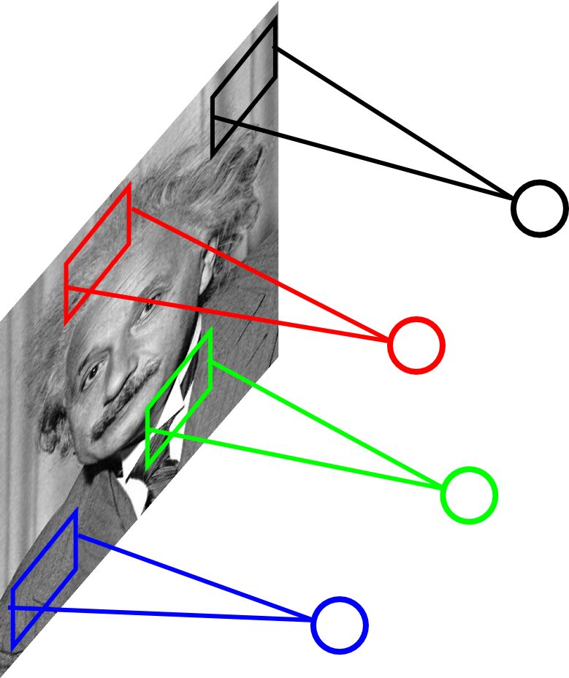
Assumption 2: Stationarity / Parameter Sharing
STATIONARITY? Statistics similar at all locations

Slide 12
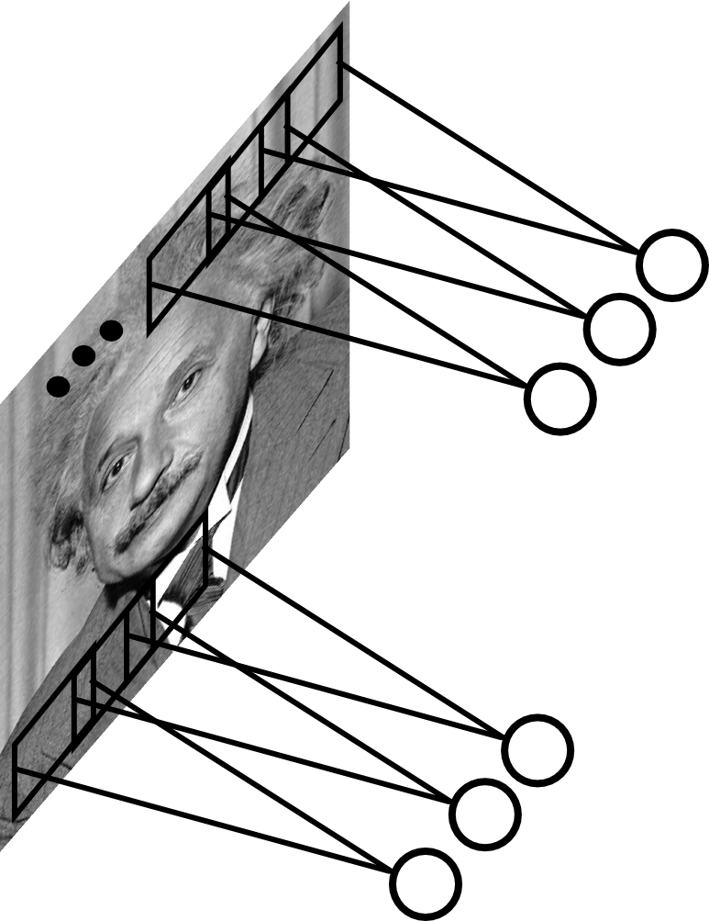
Convolutional Layer
Share the same parameters across different locations (assuming input is stationary):
Convolutions with learned kernels

Slide 13
Convolutions!

Slide 14
Convolutions for mathematicians

Slide 15


"Convolution of box signal with itself2" by Convolution_of_box_signal_with_itself.gif: Brian Ambergderivative work: Tinos (talk) - Convolution_of_box_signal_with_itself.gif. Licensed under CC BY-SA 3.0 via Commons - https://commons.wikimedia.org/wiki/File:Convolution_of_box_signal_with_itself2.gif#/media/File:Convolution_of_box_signal_with_itself2.gif

Slide 16
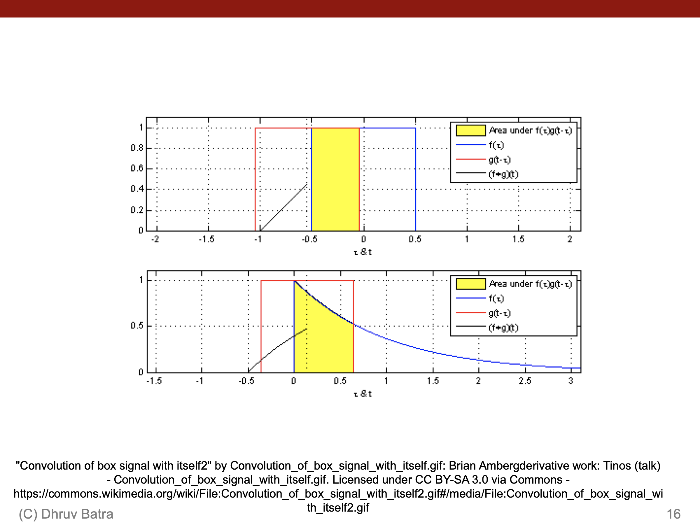
"Convolution of box signal with itself2" by Convolution_of_box_signal_with_itself.gif: Brian Ambergderivative work: Tinos (talk) - Convolution_of_box_signal_with_itself.gif. Licensed under CC BY-SA 3.0 via Commons - https://commons.wikimedia.org/wiki/File:Convolution_of_box_signal_with_itself2.gif#/media/File:Convolution_of_box_signal_with_itself2.gif

Slide 17
Convolutions for mathematicians
One dimension
Two dimensions

Slide 18
Convolutions for programmers

Slide 19
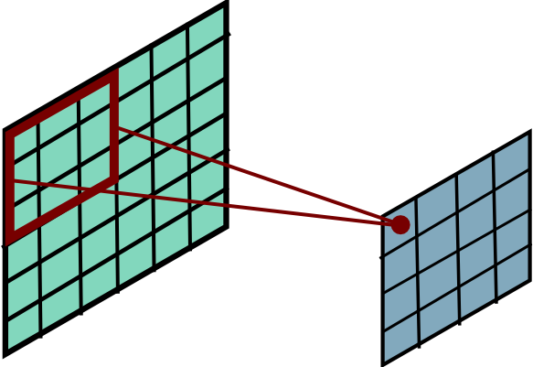
Convolutional Layer

Slide 20
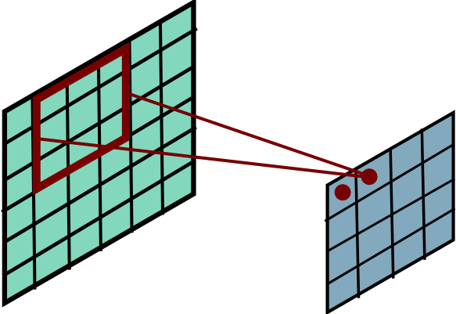
Convolutional Layer

Slide 21
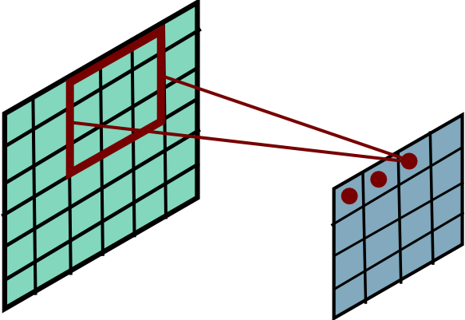
Convolutional Layer

Slide 22
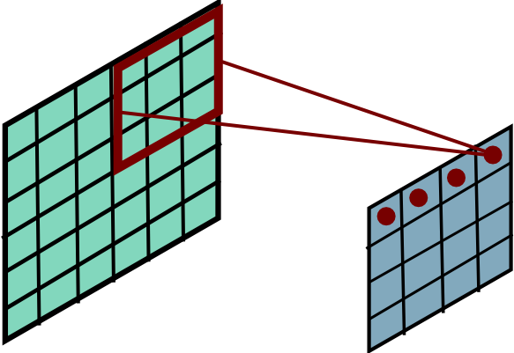
Convolutional Layer

Slide 23
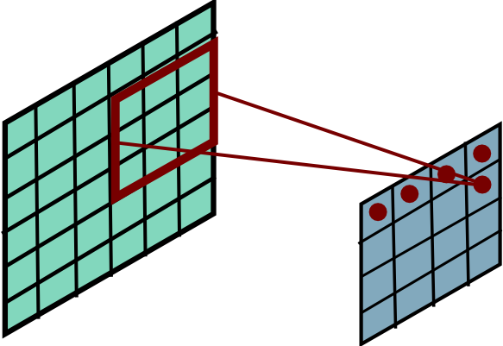
Convolutional Layer

Slide 24
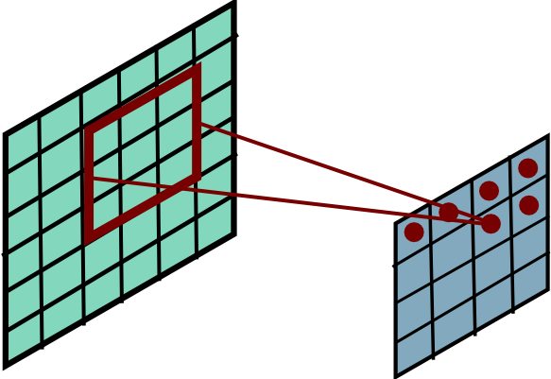
Convolutional Layer

Slide 25
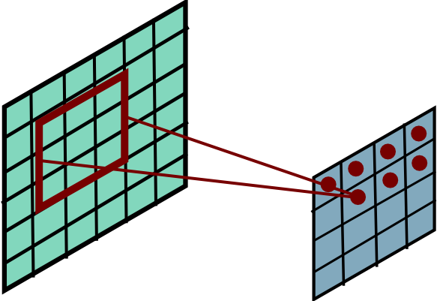
Convolutional Layer

Slide 26
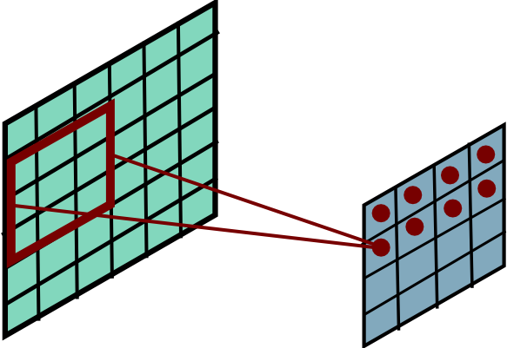
Convolutional Layer

Slide 27
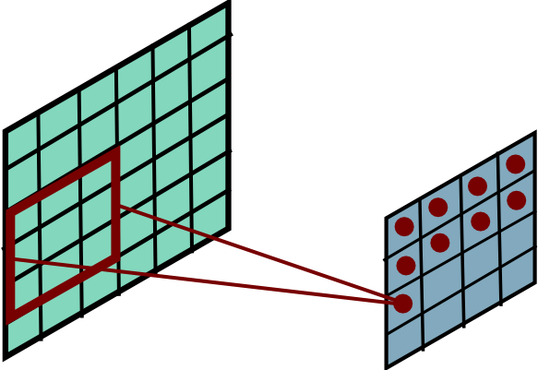
Convolutional Layer

Slide 28
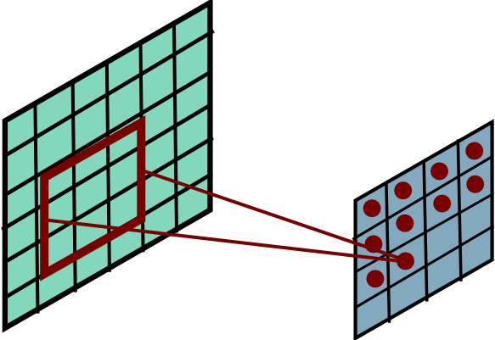
Convolutional Layer

Slide 29
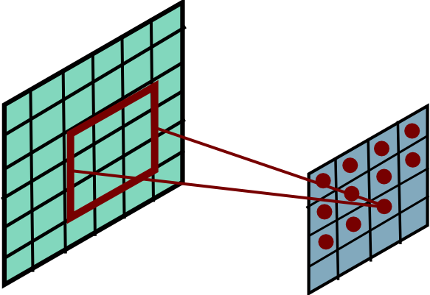
Convolutional Layer

Slide 30
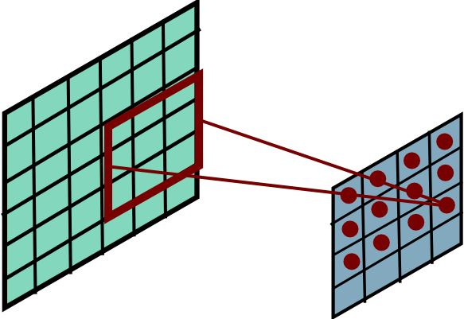
Convolutional Layer

Slide 31
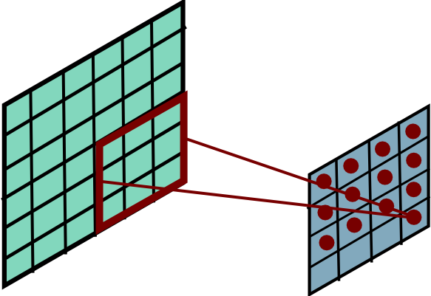
Convolutional Layer

Slide 32
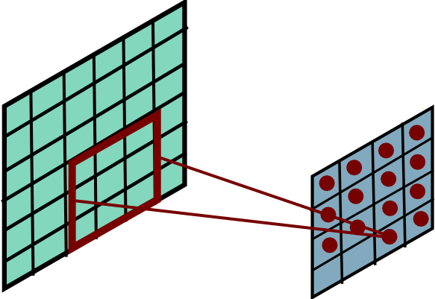
Convolutional Layer

Slide 33
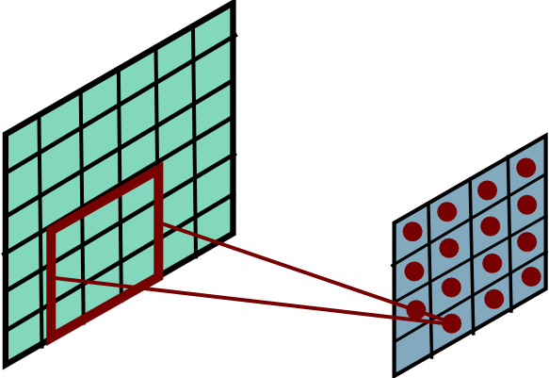
Convolutional Layer

Slide 34
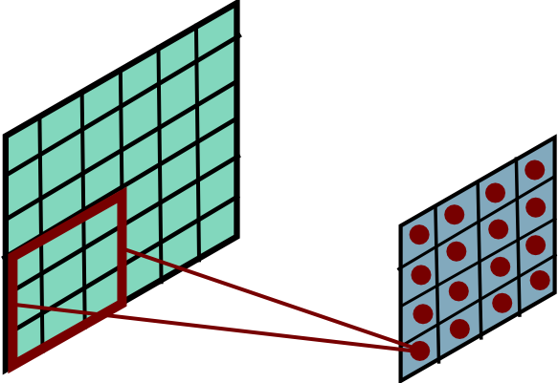
Convolutional Layer

Slide 35
Convolution Explained
http://setosa.io/ev/image-kernels/
https://github.com/bruckner/deepViz

Slide 36
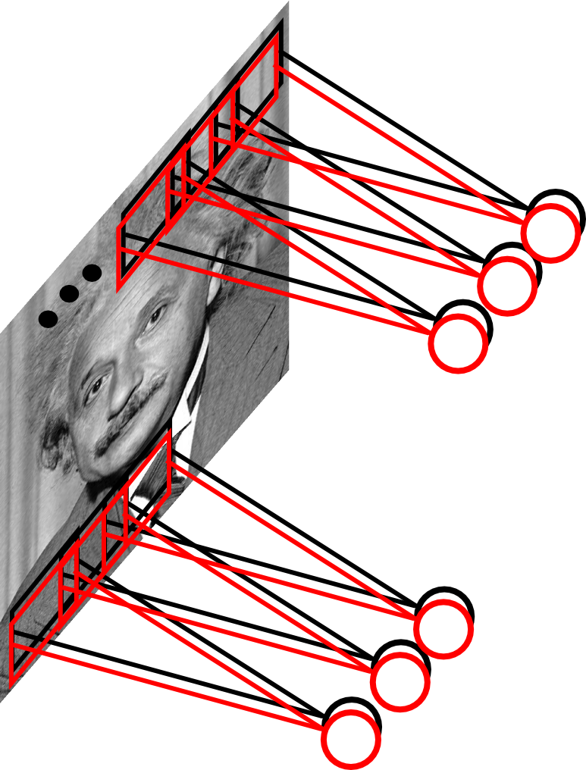
Convolutional Layer
Learn multiple filters.
E.g.: 200x200 image
100 Filters
Filter size: 10x10
10K parameters
Slide Credit: Marc'Aurelio Ranzato

Slide 37
FC vs Conv Layer

Slide 38
FC vs Conv Layer
-Stride
-Padding
-Pooling

Slide 39
Convolution Layer
32x32x3 image
32
height
32
width
3
depth
Notes:
Preserve spatial structure of input

Slide 40
Convolution Layer
32x32x3 image
5x5x3 filter
32
Convolve the filter with the image
i.e. “slide over the image spatially, computing dot products”
32
3

Slide 41
Convolution Layer
Filters always extend the full depth of the input volume
32x32x3 image
5x5x3 filter
32
Convolve the filter with the image
i.e. “slide over the image spatially, computing dot products”
32
3
Slide Credit: Fei-Fei Li, Justin Johnson, Serena Yeung, CS 231n

Slide 42

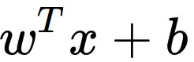
Convolution Layer
32x32x3 image
5x5x3 filter
32
1 number:
the result of taking a dot product between the filter and a small 5x5x3 chunk of the image
(i.e. 5*5*3 = 75-dimensional dot product + bias)
32
3
Slide Credit: Fei-Fei Li, Justin Johnson, Serena Yeung, CS 231n

Slide 43
Convolution Layer
activation map
32x32x3 image
5x5x3 filter
32
28
convolve (slide) over all spatial locations
32
28
3
1
Slide Credit: Fei-Fei Li, Justin Johnson, Serena Yeung, CS 231n

Slide 44
consider a second, green filter
Convolution Layer
32x32x3 image
5x5x3 filter
activation maps
32
28
convolve (slide) over all spatial locations
32
28
3
1
Slide Credit: Fei-Fei Li, Justin Johnson, Serena Yeung, CS 231n

Slide 45
For example, if we had 6 5x5 filters, we’ll get 6 separate activation maps:
activation maps
32
28
Convolution Layer
32
28
3
6
We stack these up to get a “new image” of size 28x28x6!
Slide Credit: Fei-Fei Li, Justin Johnson, Serena Yeung, CS 231n

Slide 46
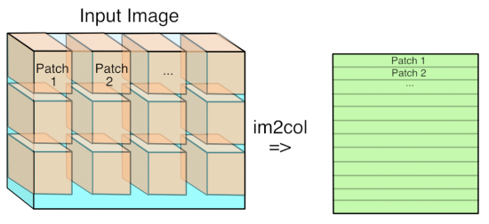
Im2Col

Slide 47
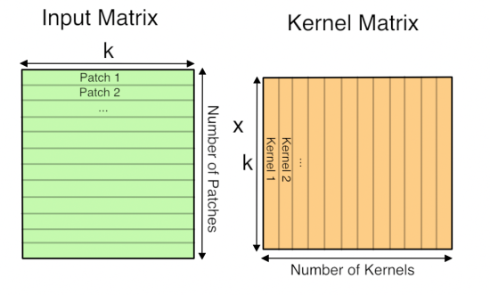
GEMM

Slide 48
Preview: ConvNet is a sequence of Convolution Layers, interspersed with activation functions
32
28
CONV,
ReLU
e.g. 6 5x5x3 filters
32
28
3
6
Slide Credit: Fei-Fei Li, Justin Johnson, Serena Yeung, CS 231n

Slide 49
Preview: ConvNet is a sequence of Convolutional Layers, interspersed with activation functions
32
28
24
….
CONV,
ReLU
e.g. 6 5x5x3 filters
CONV,
ReLU
e.g. 10 5x5x6 filters
CONV,
ReLU
32
28
24
3
6
10

Slide 50
More concepts related to CNN
Convolutional Neural Networks
Features learned by CNN layers
Stride, padding
1x1 convolutions
Pooling layers
Fully-connected layers as convolutions

Slide 51
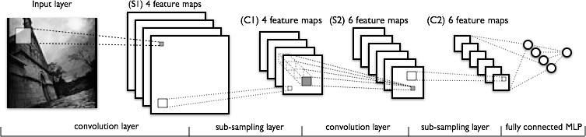
Convolutional Neural Networks
Image Credit: Yann LeCun, Kevin Murphy

Slide 52

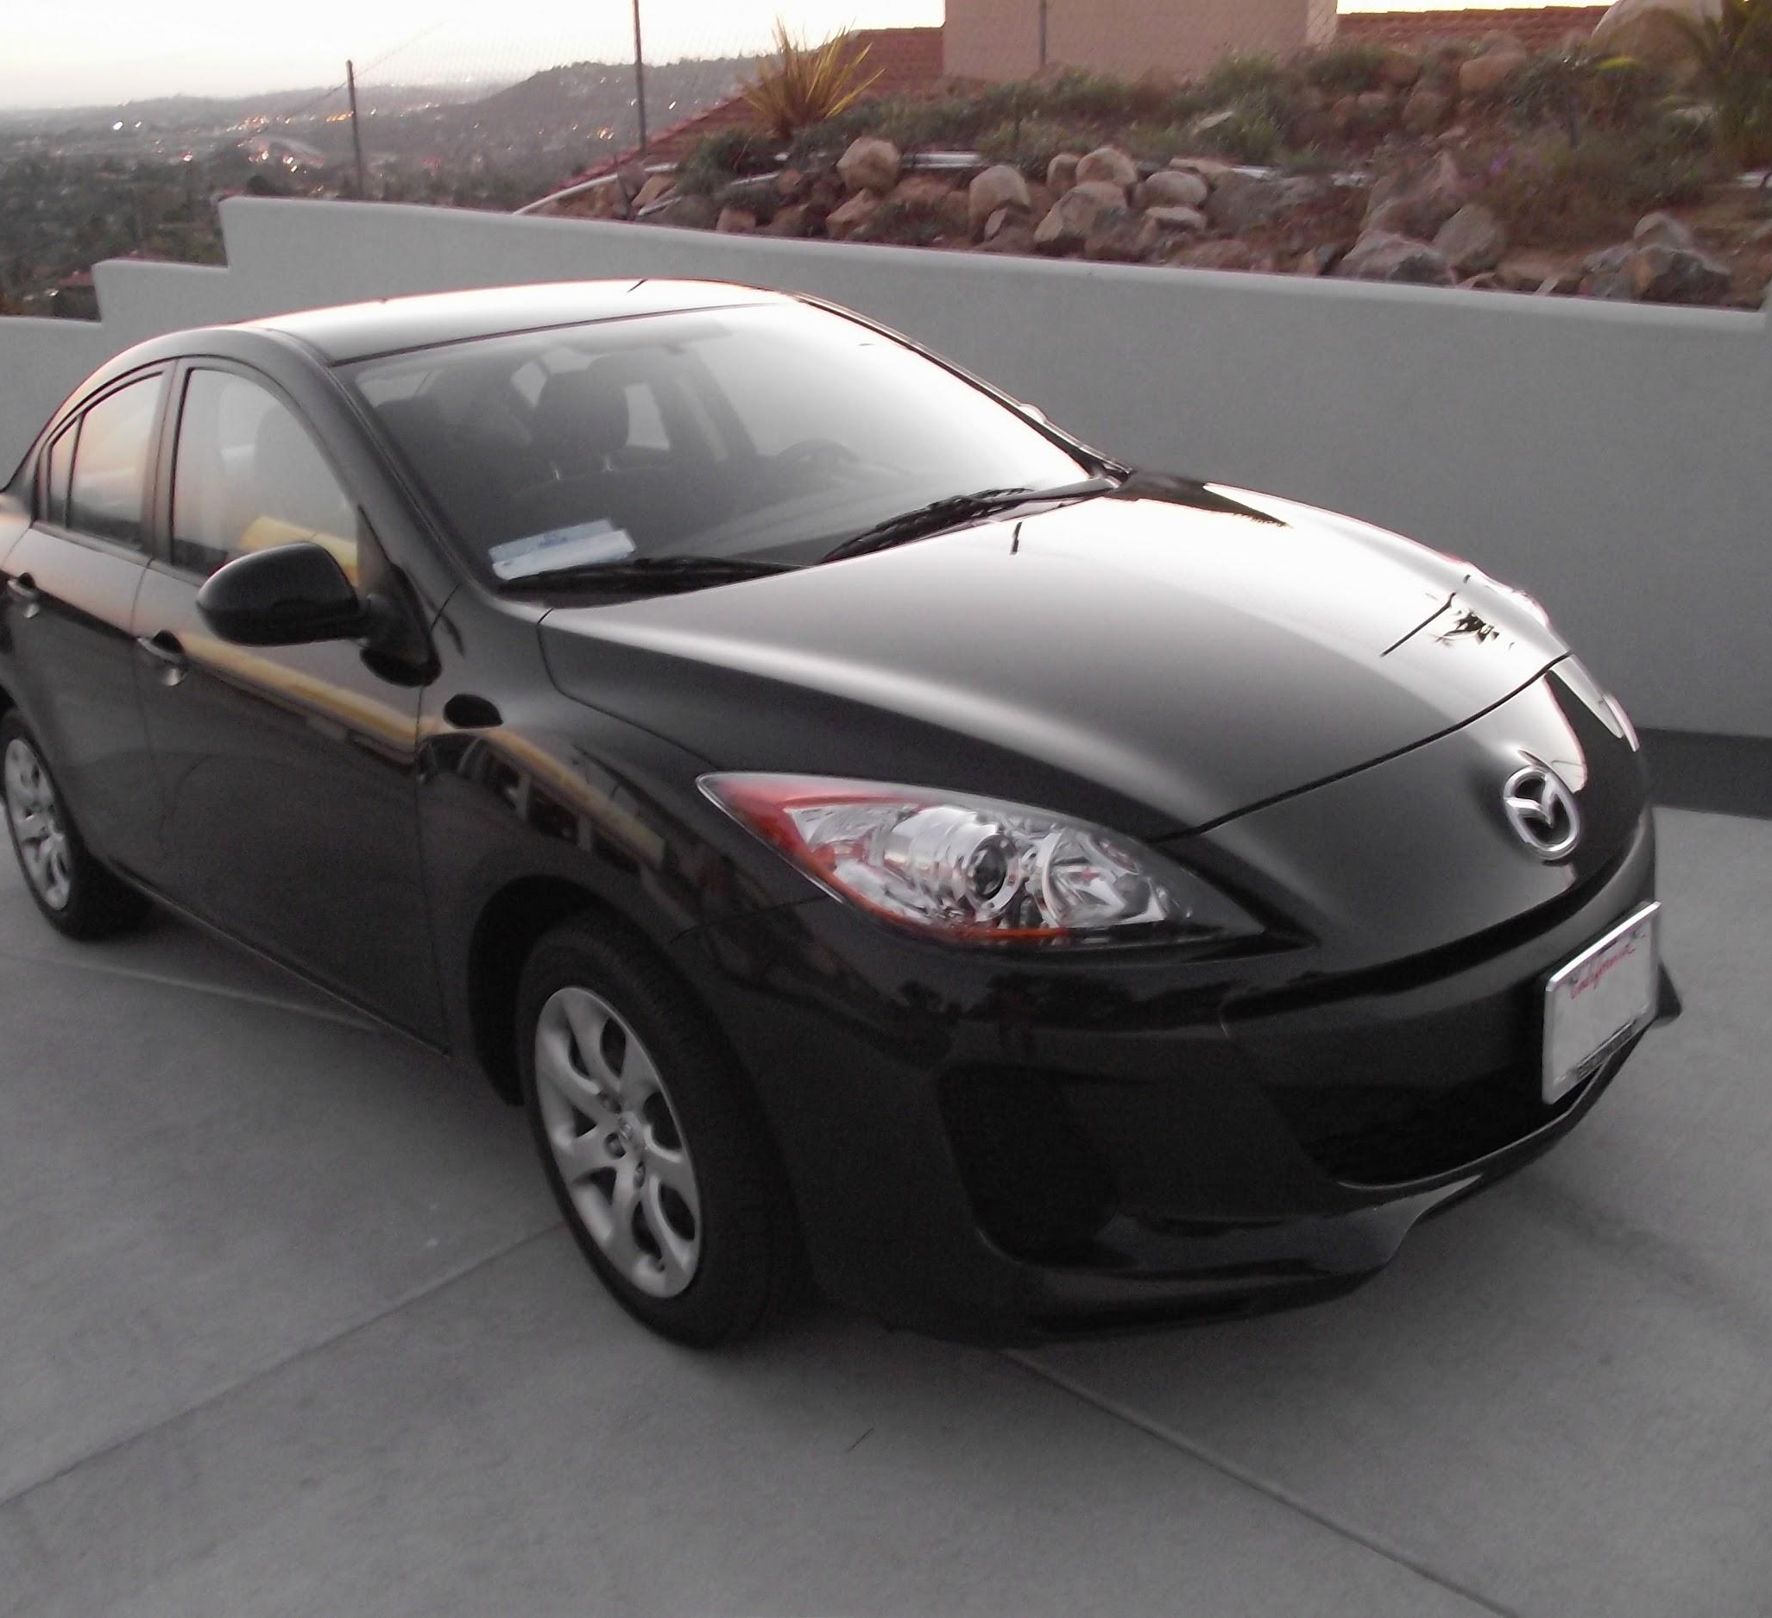
preview:
Slide Credit: Fei-Fei Li, Justin Johnson, Serena Yeung, CS 231n
Notes:
Convnet is stack of layers
Look at how an image progresses through the network, and sizes of output after each layer
Car image is photo taken by Lane McIntosh, permission to use.

Slide 53
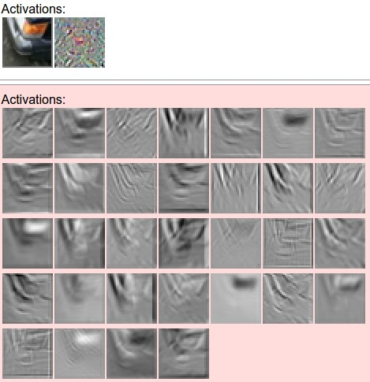
one filter =>
one activation map
example 5x5 filters
(32 total)
Figure copyright Andrej Karpathy.
Slide Credit: Fei-Fei Li, Justin Johnson, Serena Yeung, CS 231n
Notes:
Here have examples of activation maps produced by each filter
Each filter is slid over input to layer to produce an activation map
Because of sliding, call convolutional
Conv with neg. of filter (cross correlation)

Slide 54
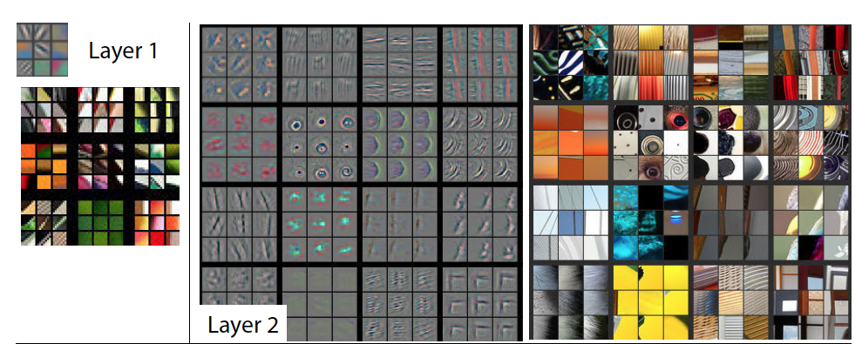
Visualizing Learned Filters
Figure Credit: [Zeiler & Fergus ECCV14]

Slide 55
Visualizing Learned Filters
Figure Credit: [Zeiler & Fergus ECCV14]

Slide 56
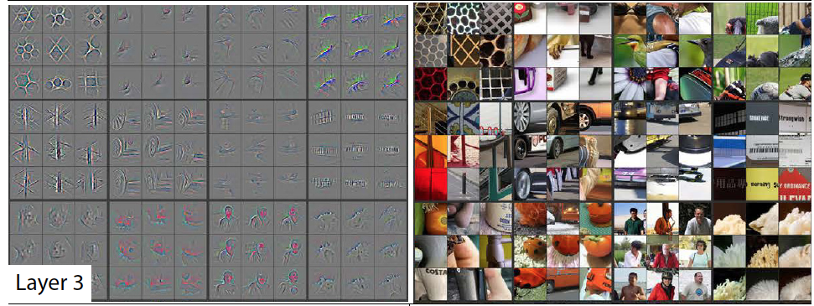
Visualizing Learned Filters
Figure Credit: [Zeiler & Fergus ECCV14]

Slide 57
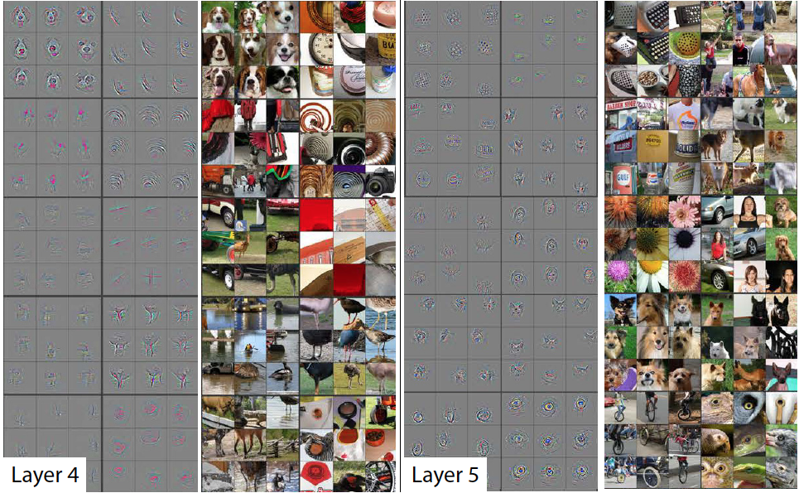
Visualizing Learned Filters
Figure Credit: [Zeiler & Fergus ECCV14]

Slide 58
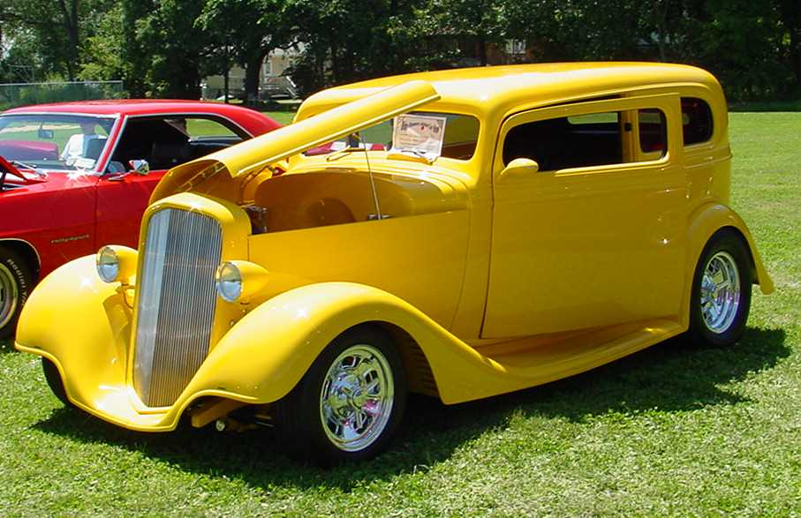
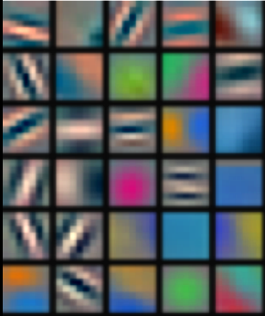
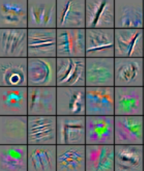
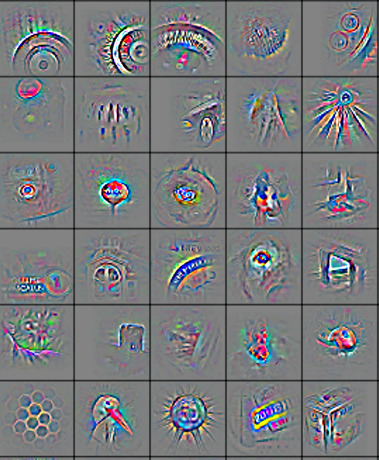
We can learn image features now!
Low-Level Feature
Mid-Level Feature
High-Level Feature
Linear Classifier
“car”
Feature visualization of convolutional net trained on ImageNet from [Zeiler & Fergus 2013]
Slide Credit: Marc'Aurelio Ranzato, Yann LeCun

Slide 59
Plan for Today
Convolutional Neural Networks
Features learned by CNN layers
Stride, padding
1x1 convolutions
Pooling layers
Fully-connected layers as convolutions

Slide 60
A closer look at spatial dimensions:
activation map
32x32x3 image
5x5x3 filter
32
28
convolve (slide) over all spatial locations
32
28
3
1
Slide Credit: Fei-Fei Li, Justin Johnson, Serena Yeung, CS 231n

Slide 61
A closer look at spatial dimensions:
7
7x7 input (spatially)
assume 3x3 filter
7
Slide Credit: Fei-Fei Li, Justin Johnson, Serena Yeung, CS 231n

Slide 62
A closer look at spatial dimensions:
7
7x7 input (spatially)
assume 3x3 filter
7
Slide Credit: Fei-Fei Li, Justin Johnson, Serena Yeung, CS 231n

Slide 63
A closer look at spatial dimensions:
7
7x7 input (spatially)
assume 3x3 filter
7
Slide Credit: Fei-Fei Li, Justin Johnson, Serena Yeung, CS 231n

Slide 64
A closer look at spatial dimensions:
7
7x7 input (spatially)
assume 3x3 filter
7
Slide Credit: Fei-Fei Li, Justin Johnson, Serena Yeung, CS 231n

Slide 65
A closer look at spatial dimensions:
7
7x7 input (spatially)
assume 3x3 filter
=> 5x5 output
7
Slide Credit: Fei-Fei Li, Justin Johnson, Serena Yeung, CS 231n

Slide 66
A closer look at spatial dimensions:
7
7x7 input (spatially)
assume 3x3 filter
applied with stride 2
7
Slide Credit: Fei-Fei Li, Justin Johnson, Serena Yeung, CS 231n

Slide 67
A closer look at spatial dimensions:
7
7x7 input (spatially)
assume 3x3 filter
applied with stride 2
7
Slide Credit: Fei-Fei Li, Justin Johnson, Serena Yeung, CS 231n

Slide 68
A closer look at spatial dimensions:
7
7x7 input (spatially)
assume 3x3 filter
applied with stride 2
=> 3x3 output!
7
Slide Credit: Fei-Fei Li, Justin Johnson, Serena Yeung, CS 231n

Slide 69
A closer look at spatial dimensions:
7
7x7 input (spatially)
assume 3x3 filter
applied with stride 3?
7
Slide Credit: Fei-Fei Li, Justin Johnson, Serena Yeung, CS 231n

Slide 70
A closer look at spatial dimensions:
7
7x7 input (spatially)
assume 3x3 filter
applied with stride 3?
7
doesn’t fit!
cannot apply 3x3 filter on 7x7 input with stride 3.
Slide Credit: Fei-Fei Li, Justin Johnson, Serena Yeung, CS 231n

Slide 71
N
Output size:
(N - F) / stride + 1
e.g. N = 7, F = 3:
stride 1 => (7 - 3)/1 + 1 = 5
stride 2 => (7 - 3)/2 + 1 = 3
stride 3 => (7 - 3)/3 + 1 = 2.33 :\
F
F
N
Slide Credit: Fei-Fei Li, Justin Johnson, Serena Yeung, CS 231n

Slide 72
Remember back to…
E.g. 32x32 input convolved repeatedly with 5x5 filters shrinks volumes spatially!
(32 -> 28 -> 24 ...). Shrinking too fast is not good, doesn’t work well.
32
28
24
….
CONV,
ReLU
e.g. 6 5x5x3 filters
CONV,
ReLU
e.g. 10 5x5x6 filters
CONV,
ReLU
32
28
24
3
6
10
Slide Credit: Fei-Fei Li, Justin Johnson, Serena Yeung, CS 231n

Slide 73
In practice: Common to zero pad the border
0 | 0 | 0 | 0 | 0 | 0
0
0
0
0
e.g. input 7x7
3x3 filter, applied with stride 1
pad with 1 pixel border => what is the output?
(recall:)
(N - F) / stride + 1
Slide Credit: Fei-Fei Li, Justin Johnson, Serena Yeung, CS 231n

Slide 74
In practice: Common to zero pad the border
0 | 0 | 0 | 0 | 0 | 0
0
0
0
0
e.g. input 7x7
3x3 filter, applied with stride 1
pad with 1 pixel border => what is the output?
7x7 output!
Slide Credit: Fei-Fei Li, Justin Johnson, Serena Yeung, CS 231n

Slide 75
In practice: Common to zero pad the border
0 | 0 | 0 | 0 | 0 | 0
0
0
0
0
e.g. input 7x7
3x3 filter, applied with stride 1
pad with 1 pixel border => what is the output?
7x7 output!
in general, common to see CONV layers with stride 1, filters of size FxF, and zero-padding with (F-1)/2. (will preserve size spatially)
e.g. F = 3 => zero pad with 1
F = 5 => zero pad with 2
F = 7 => zero pad with 3
Slide Credit: Fei-Fei Li, Justin Johnson, Serena Yeung, CS 231n

Slide 76
Examples time:
Input volume: 32x32x3
10 5x5 filters with stride 1, pad 2
Output volume size: ?
Slide Credit: Fei-Fei Li, Justin Johnson, Serena Yeung, CS 231n
Notes:
(32+2*2-5)/1+1 = 32 spatially
(Input size + 2*padding - stride) / 1 + 1 for new spatial size
10 filters

Slide 77
Examples time:
Input volume: 32x32x3
10 5x5 filters with stride 1, pad 2
Output volume size:
(32+2*2-5)/1+1 = 32 spatially, so
32x32x10
Slide Credit: Fei-Fei Li, Justin Johnson, Serena Yeung, CS 231n

Slide 78
Examples time:
Input volume: 32x32x3
10 5x5 filters with stride 1, pad 2
Number of parameters in this layer?
Slide Credit: Fei-Fei Li, Justin Johnson, Serena Yeung, CS 231n
Notes:
each filter has 5*5*3 + 1 = 76 params
1 for bias

Slide 79
Examples time:
Input volume: 32x32x3
10 5x5 filters with stride 1, pad 2
Number of parameters in this layer?
each filter has 5*5*3 + 1 = 76 params (+1 for bias)
=> 76*10 = 760
Slide Credit: Fei-Fei Li, Justin Johnson, Serena Yeung, CS 231n

Slide 80
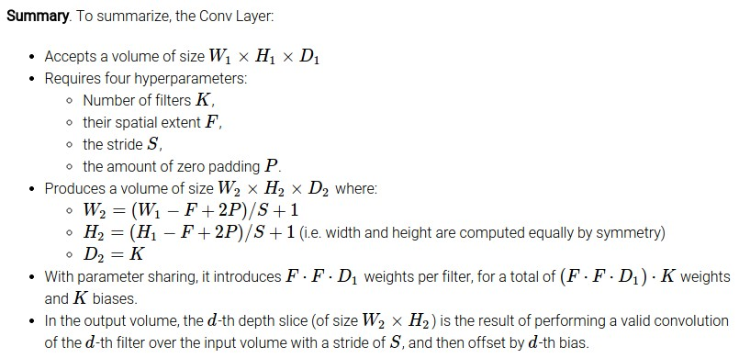
Slide Credit: Fei-Fei Li, Justin Johnson, Serena Yeung, CS 231n

Slide 81
Common settings:
K = (powers of 2, e.g. 32, 64, 128, 512)
F = 3, S = 1, P = 1
F = 5, S = 1, P = 2
F = 5, S = 2, P = ? (whatever fits)
F = 1, S = 1, P = 0
Slide Credit: Fei-Fei Li, Justin Johnson, Serena Yeung, CS 231n

Slide 82
Plan for Today
Convolutional Neural Networks
Features learned by CNN layers
Stride, padding
1x1 convolutions
Pooling layers
Fully-connected layers as convolutions
Backprop in conv layers

Slide 83
Can we have 1x1 filters?

Slide 84
1x1 convolution layers make perfect sense
1x1 CONV
with 32 filters
56
56
(each filter has size 1x1x64, and performs a 64-dimensional dot product)
56
56
64
32
Slide Credit: Fei-Fei Li, Justin Johnson, Serena Yeung, CS 231n

Slide 85
Fully Connected Layer as 1x1 Conv
32x32x3 image -> stretch to 3072 x 1
input
activation
1
1
3072
10 x 3072
weights
10
1 number:
the result of taking a dot product between a row of W and the input (a 3072-dimensional dot product)
Slide Credit: Fei-Fei Li, Justin Johnson, Serena Yeung, CS 231n
Notes:
Preserve spatial structure of input

Slide 86
Plan for Today
Convolutional Neural Networks
Stride, padding
1x1 convolutions
Backprop in conv layers [Derived in notes]
Pooling layers
Fully-connected layers as convolutions
Toeplitz matrices and convolutions = matrix-mult

Slide 87
two more layers to go: POOL/FC
Slide Credit: Fei-Fei Li, Justin Johnson, Serena Yeung, CS 231n
Notes:
Car image is photo taken by Lane McIntosh, permission to use.

Slide 88
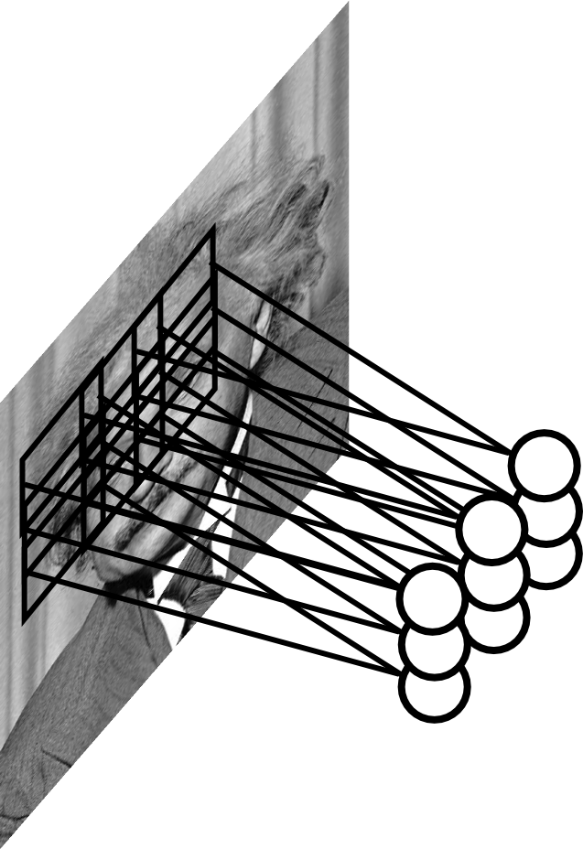
Pooling Layer
Let us assume filter is an “eye” detector.
Q.: how can we make the detection robust to the exact location of the eye?
Slide Credit: Marc'Aurelio Ranzato

Slide 89

Pooling layer
makes the representations smaller and more manageable
operates over each activation map independently:
Slide Credit: Fei-Fei Li, Justin Johnson, Serena Yeung, CS 231n

Slide 90
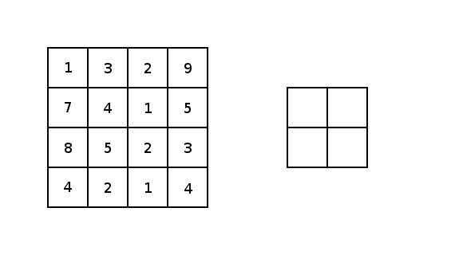
Image courtesy: Justin Francis.

Slide 91
Pooling Layer: Examples
Max-pooling:
Average-pooling:
L2-pooling:
Slide Credit: Marc'Aurelio Ranzato

Slide 92
Receptive Field
Conv.
layer
Pool.
layer
Slide Credit: Marc'Aurelio Ranzato

Slide 93
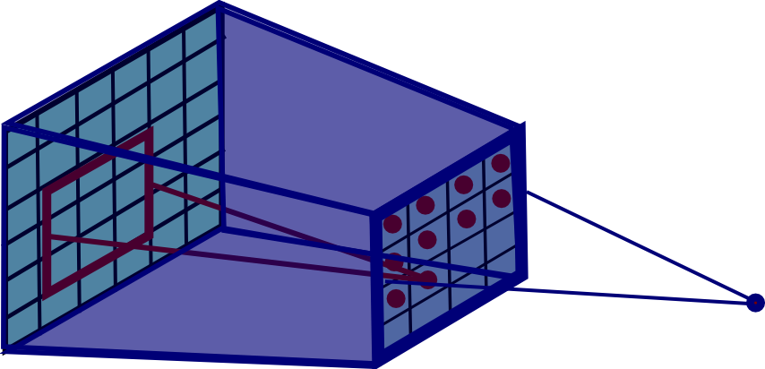
Pooling Layer: Receptive Field Size
Conv.
layer
Pool.
layer
Slide Credit: Marc'Aurelio Ranzato

Slide 94
Pooling Layer: Receptive Field Size
Conv.
layer
Pool.
layer
If convolutional filters are FxF and stride 1, and pooling layer has pools of size PxP, then each unit in the pooling layer depends upon a patch in h^{(l-1)} of size: (P+F-1)x(P+F-1)
Slide Credit: Marc'Aurelio Ranzato

Slide 95
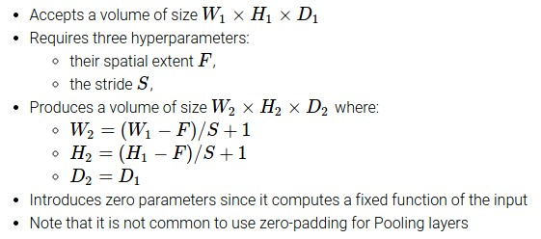
Slide Credit: Fei-Fei Li, Justin Johnson, Serena Yeung, CS 231n

Slide 96
Common settings:
F = 2, S = 2
F = 3, S = 2
Slide Credit: Fei-Fei Li, Justin Johnson, Serena Yeung, CS 231n

Slide 97
Fully Connected Layer (FC layer)
Contains neurons that connect to the entire input volume, as in ordinary Neural Networks
Slide Credit: Fei-Fei Li, Justin Johnson, Serena Yeung, CS 231n
Notes:
Car image is photo taken by Lane McIntosh, permission to use.

Slide 98
Convolutional Neural Networks
Image Credit: Yann LeCun, Kevin Murphy

Slide 99
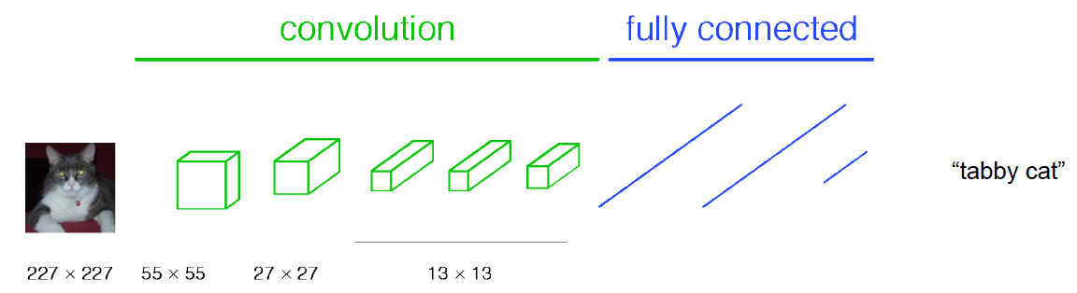
Classical View
Figure Credit: [Long, Shelhamer, Darrell CVPR15]

Slide 100
C₂ hidden units
NxNxC₁, N small
Fully conn. layer
Slide Credit: Marc'Aurelio Ranzato

Slide 101
Classical View
Figure Credit: [Long, Shelhamer, Darrell CVPR15]

Slide 102
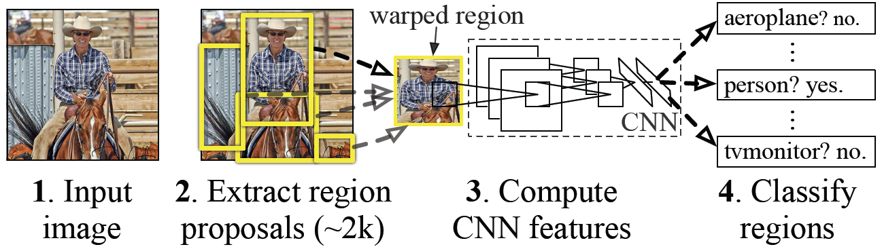
Classical View = Inefficient

Slide 103
Classical View
Figure Credit: [Long, Shelhamer, Darrell CVPR15]

Slide 104
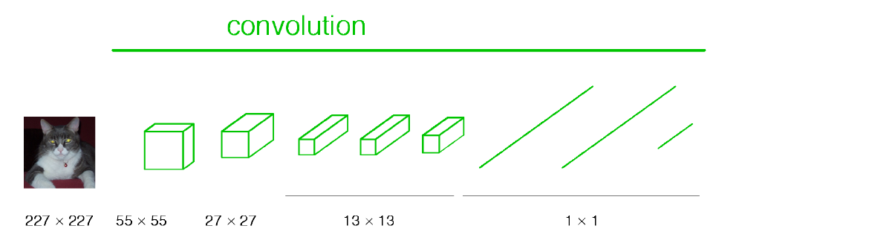
Re-interpretation
Just squint a little!
Figure Credit: [Long, Shelhamer, Darrell CVPR15]

Slide 105
C₂ hidden units /
1x1xC₂ feature maps
NxNxC₁, N small
Fully conn. layer /
Conv. layer (C₂ kernels of size NxNxC₁)
Slide Credit: Marc'Aurelio Ranzato

Slide 106
Re-interpretation
Just squint a little!
Figure Credit: [Long, Shelhamer, Darrell CVPR15]

Slide 107
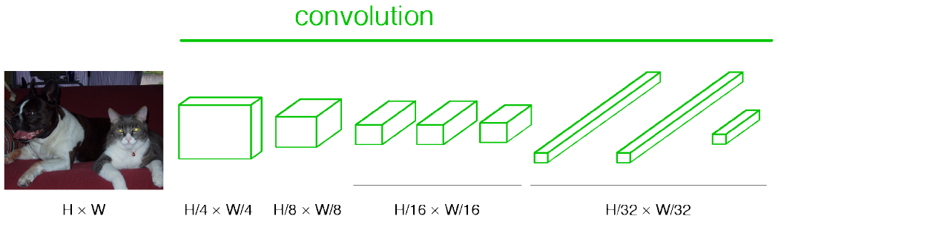
“Fully Convolutional” Networks
Can run on an image of any size!
Figure Credit: [Long, Shelhamer, Darrell CVPR15]

Slide 108

“Fully Convolutional” Networks
Up-sample to get segmentation maps
Figure Credit: [Long, Shelhamer, Darrell CVPR15]

Slide 109
Benefit of this thinking
Mathematically elegant
Efficiency
Can run network on arbitrary image
Without multiple crops

